Slide 1
Health Information System
Presented by: Onyango Jack Oluoch Date: 24/04/2025

Slide 2
Project Overview
Objective: Build a basic health information system for doctors to manage clients and health programs.
Key Features:
Create health programs (e.g., TB, Malaria, HIV).
Register new clients.
Enroll clients in programs.
Search for clients.
View client profiles with enrolled programs.
Expose client profiles via an API.
Technology Stack: MERN (MongoDB, Express, React, Node.js)

Slide 3
Approach
Step 1: Requirements Analysis
Identified 6 key features required by the doctor.
Focused on simplicity and usability for healthcare professionals.
Step 2: Technology Selection
Chose MERN stack for full JavaScript development.
Used Vite + React for a fast frontend development experience.
Step 3: Development
Split into backend (Node.js/Express) and frontend (React).
Backend: REST API with MongoDB for data storage.
Frontend: Single-page application with routing.
Step 4: Testing & Deployment
Tested locally with MongoDB running.
Pushed to GitHub for review.

Slide 4
System Design
Architecture Overview:
Frontend: React (Vite) for UI, communicates with backend via API.
Backend: Node.js/Express for API, MongoDB for data storage.
Communication: REST API (HTTP requests).
Data Flow:
Doctor interacts with React UI.
UI sends HTTP requests to Express API.
Express interacts with MongoDB to store/retrieve data.
API responses are displayed on the UI.

Slide 5
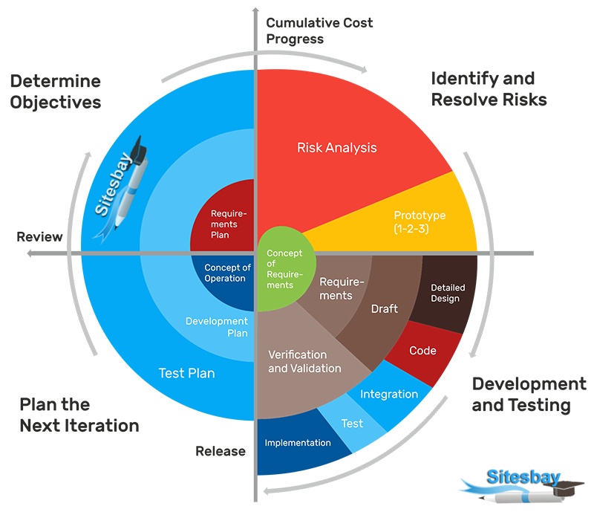
System Design Model

Slide 6
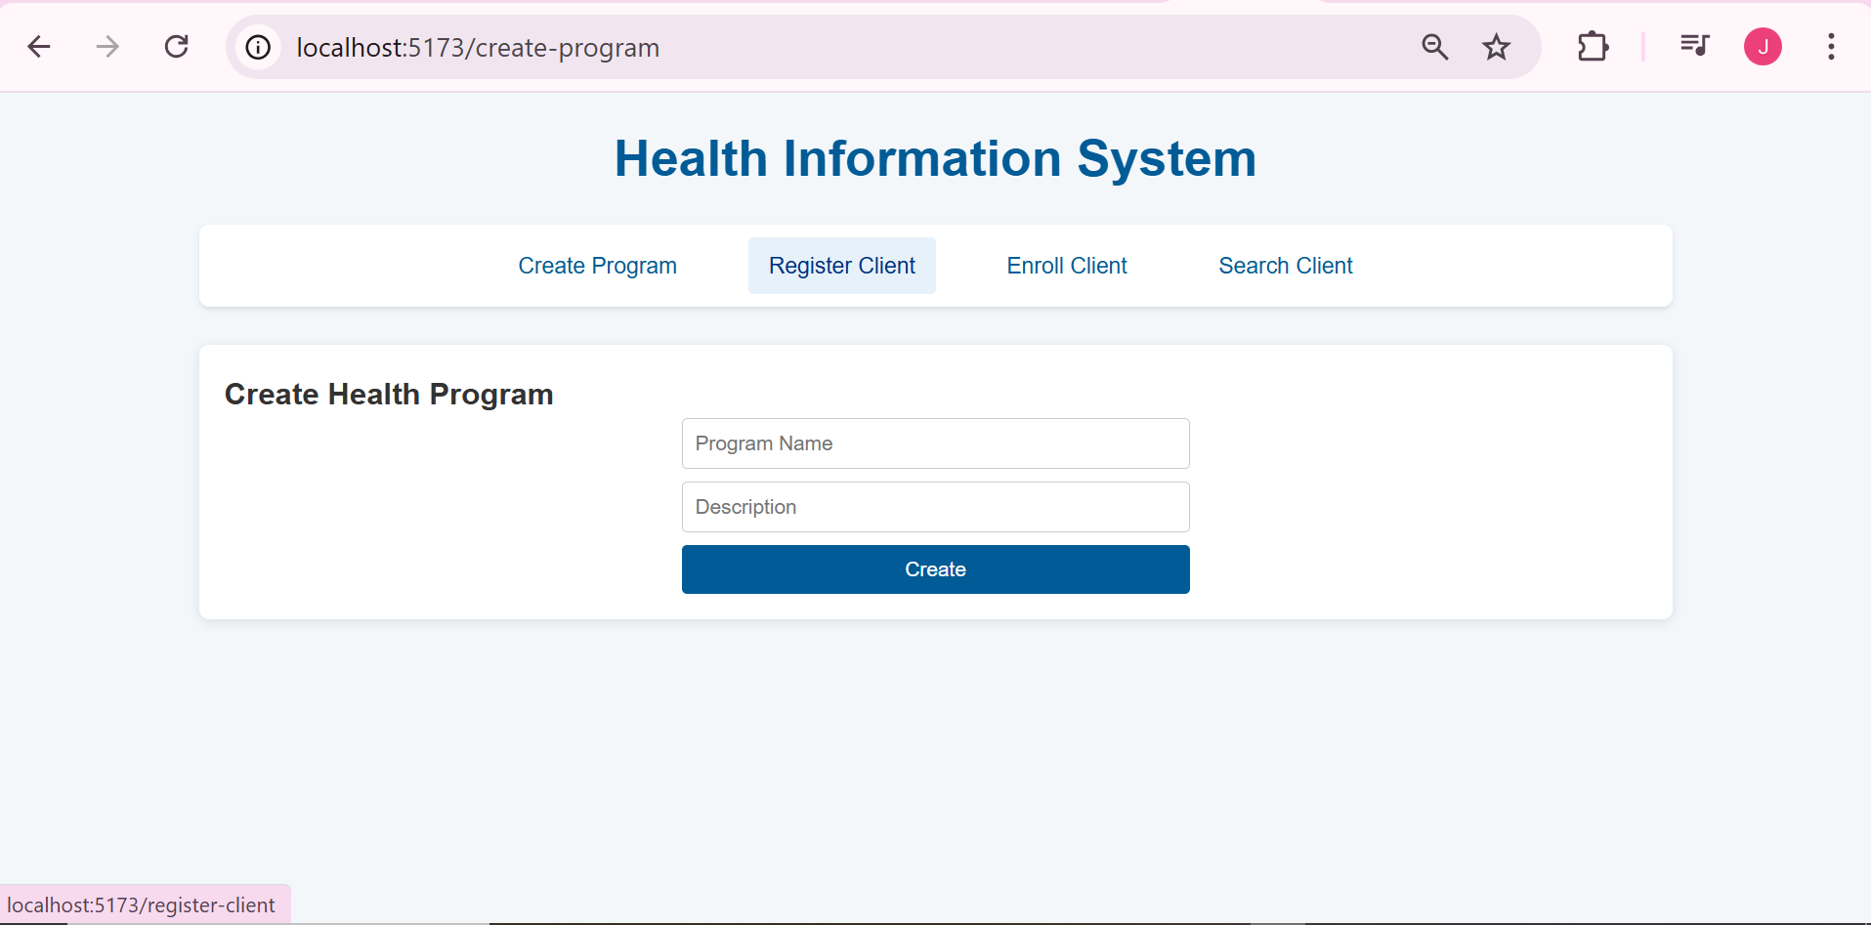
Create Program Page

Slide 7
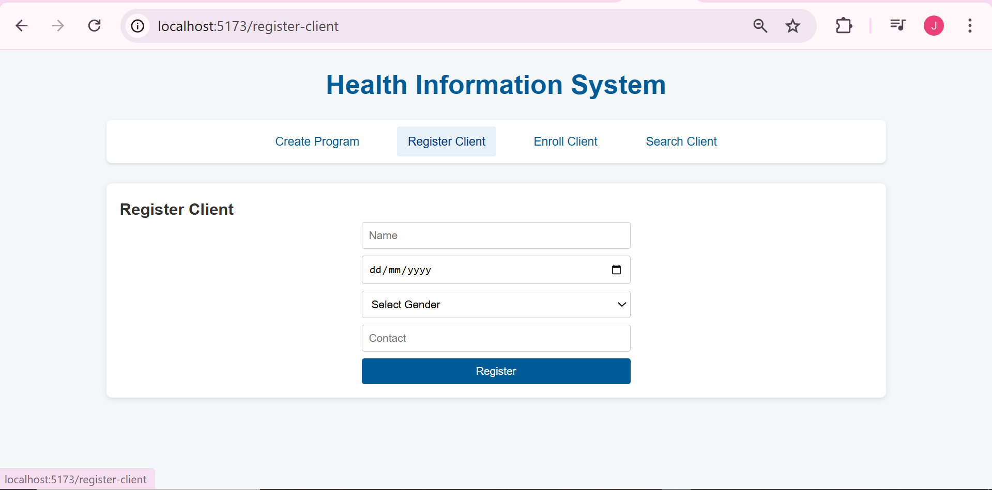
Register Client Page

Slide 8
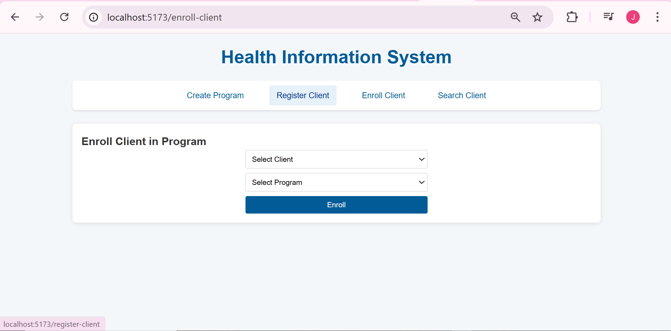
Enroll Client Page

Slide 9
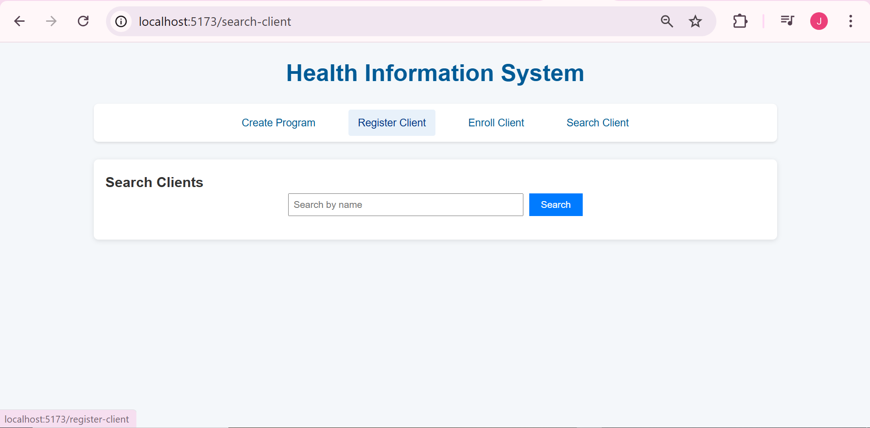
Search Client Page

Slide 10
Database
MongoDB Schemas:
Client:
name: String (required)
dateOfBirth: Date (required)
gender: Enum ["Male", "Female", "Other"] (required)
contact: String (required)
programs: Array of Program IDs (references)
Program:
name: String (required, unique)
description: String (optional)
Relationships:
A Client can be enrolled in multiple Programs (one-to-many relationship).

Slide 11
Solution
1. Create a Health Program:
Page: /create-program → CreateProgram component.(API: POST /api/programs).
2. Register a New Client: Page: /register-client → RegisterClient component.
API: POST /api/clients.
3. Enroll a Client in Programs: Page: /enroll-client → EnrollClient component.
API: POST /api/clients/:clientId/enroll.
4. Search for a Client: Page: /search-client → SearchClient component.
API: GET /api/clients?name=<searchTerm>.
5. View a Client’s Profile: Page: /client/:id → ClientProfile component. (API: GET /api/clients/:id.)
6. Expose Client Profile via API: (API: GET /api/clients/:id (publicly accessible)).
7. UI Design:Clean, healthcare-inspired design (blue and white color scheme).
8. Styling:Used App.css for consistent styling.

Slide 12


